Slide 1
DSCI 504: OPC Corporate Back Brief
October 15, 2022
Symphony Hopkins

Slide 2
Overview
Introduction to Relational Databases and PostgreSQL
OPC Data Overview
BASIC SQL Coding Principles
Building the Database
Working with Data in PostgreSQL
Intermediate SQL Functions
Advanced SQL Functions
Query Optimization
Key Findings
Lessons Learned
Recommendations
Sources

Slide 3
1. Introduction to Relational Databases and PostgreSQL
“Relational databases became dominant in the 1980s. Items in a relational database are organized as a set of tables with columns and rows. Relational database technology provides the most efficient and flexible way to access structured information.” (Oracle)
PostgreSQL is an object-relational database management system that expands upon the SQL language to provide additional features.
Our primary goal is to use PostgreSQL to build and manage the OPC database; and to perform analyses to determine if it is beneficial to bring on Ord Cycles.

Slide 4
2. OPC Data Overview
The data consists of approximately 2,600 sales transactions from the years 2000 – 2020. The data does not represent all sales, but it is enough to perform analyses.
We were provided 14 tables (totaling 47 columns of data) containing information about clients, orders, warehouses, bike components, suppliers, etc.

Slide 5
3. Basic SQL Coding Principles
The ANSI/ISO SQL standard does not define how to properly write SQL programming code; however, there have been many style guides provided to demonstrate good, written SQL programming.
The code observed in this presentation and markdown file will follow the standards suggested by Professor Brandon Bean and Joe Celko’s SQL Programming Style Guide (2005).

Slide 6
4a. Building the Database: Database Normalization
Database normalization is the process of organizing tables into unary structures. It is important because it…
Optimizes searching over the database and tables.
Reduces the possibility of data duplication and modification anomalies.
There are three common forms of database normalization: 1st, 2nd, and 3rd normal form.
We were provided 14 tables that were at the very least in 1st normal form, which means that the data was stored in a relational table with no repeating groups of columns.

Slide 7
4b. Building the Database: Data Definition Language (DDL)
DDL keywords (e.g., CREATE, ALTER, DROP) allows us to create, manage, and analyze objects in a database.
To create the OPC database, we first created a new schema, ‘dsci_504’.
Within that schema, we created 14 new tables: builds, components, customers, customerwarehouseorders, customerwarehousereturns, orders, ordertaxes, productbuilds, products, racs, states, suppliers, taxes, warehouses.

Slide 8
4c. Building the Database: Importing Data Into PostgreSQL
PostgreSQL allows users to import and export flat files using the COPY command.
Using the CSV files provided by OPC, we imported the data into the tables we previously created.
Then, we assigned the tables primary and foreign keys to elevate the database to 2nd normal form.

Slide 9
5a. Working with Data in PostgreSQL: Using Queries to Answer Research Questions
To re-iterate, we wanted to use PostgreSQL to…
Build the OPC database ✓
Perform analyses to determine if it is beneficial to bring on Ord Cycles
Now that we have a database, we want to work with the data to answer the following questions:
Does OPC have adequate sales to support continued growth in the mountain bike segment?
Will the acquisition of Ord Cycles require OPC to increase its number of warehouses to meet demand?
Should Ord Cycles be acquired, what configurations of mountain bikes should OPC require Ord Cycles to build based on available data?
Using basic SQL queries (e.g., SELECT, DISTINCT, WHERE) , we will try to gather insight on OPC data to see if we can find answers.

Slide 10
5b. Working with Data in PostgreSQL: Executing Basic Queries
Question: Does OPC have adequate sales to support continued growth in the mountain bike segment?
Query: Find how many orders were made in 2017-2019.
Answer: From the number of returned rows, we can see that there were 134, 135, 121 orders respectively (Section 1A)
Conclusion: The number of orders has slightly decreased, and one can assume that less orders, means less sales; however, we need more advanced SQL functions before we can make that assessment.
Question: Will the acquisition of Ord Cycles require OPC to increase its number of warehouses to meet demand?
Query: Find the total number of warehouses.
Answer: There are 3 warehouses (Section 1B).
Conclusion: Now that we know there are three warehouses, we will need to use more advanced SQL queries to determine how many orders each warehouse deals with.
Question: Should Ord Cycles be acquired, what configurations of mountain bikes should OPC require Ord Cycles to build based on available data?
Query: Find the total number of mountain bikes.
Answer: There are 69 different mountain bikes (Section 1C).
Conclusion: We know that there are 69 mountain bikes. Using a more advanced SQL query, we should determine which mountain bikes are ordered the most from customers.

Slide 11
6a. Intermediate SQL Functions: Defining Intermediate Functions
Intermediate SQL functions can aggregate columns (e.g., AVG, SUM, COUNT), join data tables (e.g., INNER JOIN, OUTER JOIN), and transform values based on conditions (e.g., CASE WHEN).
We will be using these functions to gather more insight on the OPC data.

Slide 12
6b. Intermediate SQL Functions: Executing Intermediate Queries
Question: Does OPC have adequate sales to support continued growth in the mountain bike segment?
Query: Find the total sales of mountain bikes for each year.
Answer: It is difficult to gauge a general trend of the sales. However, in 2018 - 2019, it seems that the sales has decreased. (Section 2A).
Conclusion: More information is needed to understand the decrease in sales in recent years (i.e., Supplier issues during the pandemic? Lack of data?)
Question: Will the acquisition of Ord Cycles require OPC to increase its number of warehouses to meet demand?
Query: Find how many orders each warehouse has handled.
Answer: For Warehouses 1, 2, and 3, they handled 884, 859, and 856 respectively (Section 2B).
Conclusion: We can see that each warehouse approximately handles the same number of orders. Let’s see if these warehouses can handle the number of orders by looking at the shipping times.
Question: Should Ord Cycles be acquired, what configurations of mountain bikes should OPC require Ord Cycles to build based on available data?
Query: Find the total orders for the top 10 most ordered mountain bike.
Answer: Occam was the most ordered bike. Details on other bikes in next slide. (Section 2C)
Conclusion: Now that we now which bikes are most popular overall, let’s look at which bikes are the most popular in the recent years so we can determine which bikes we should focus on.

Slide 13
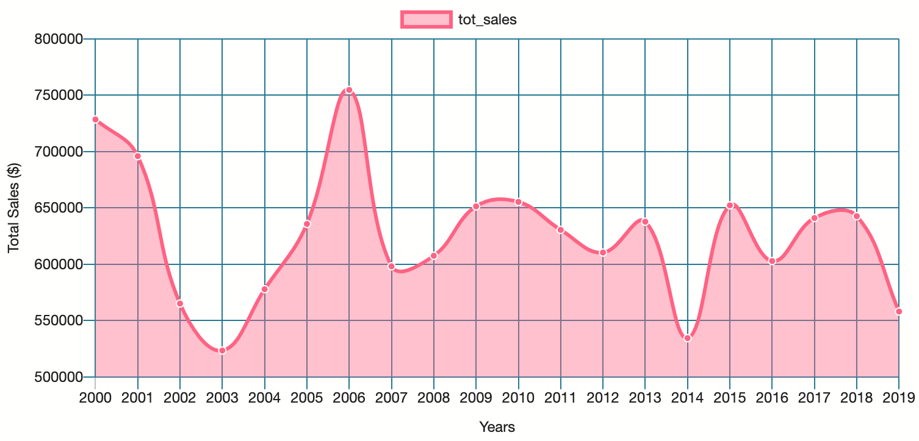
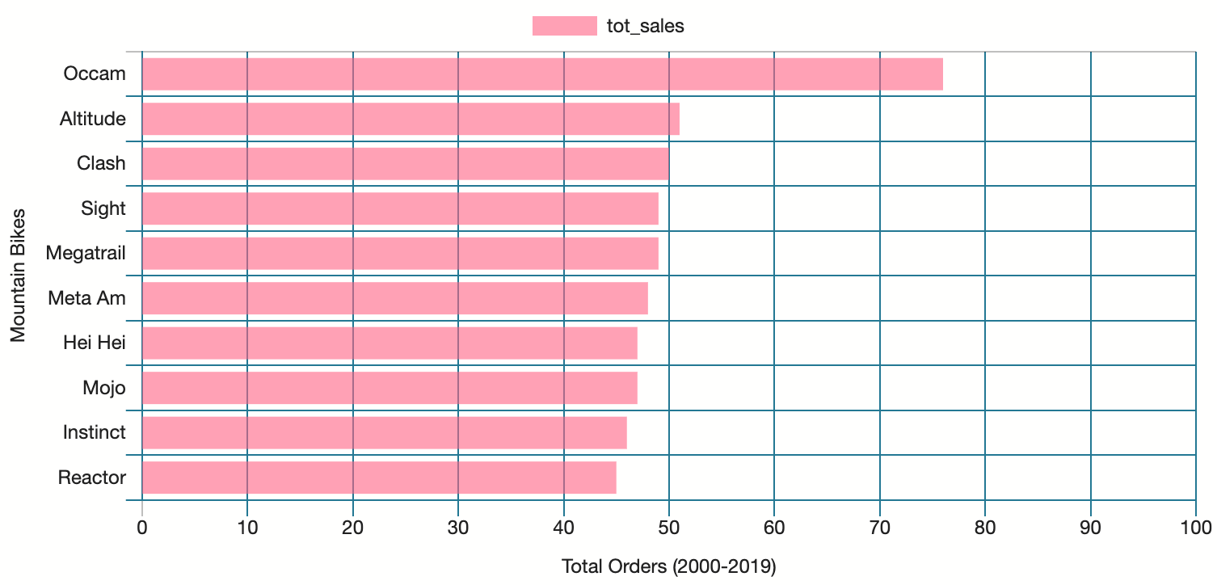
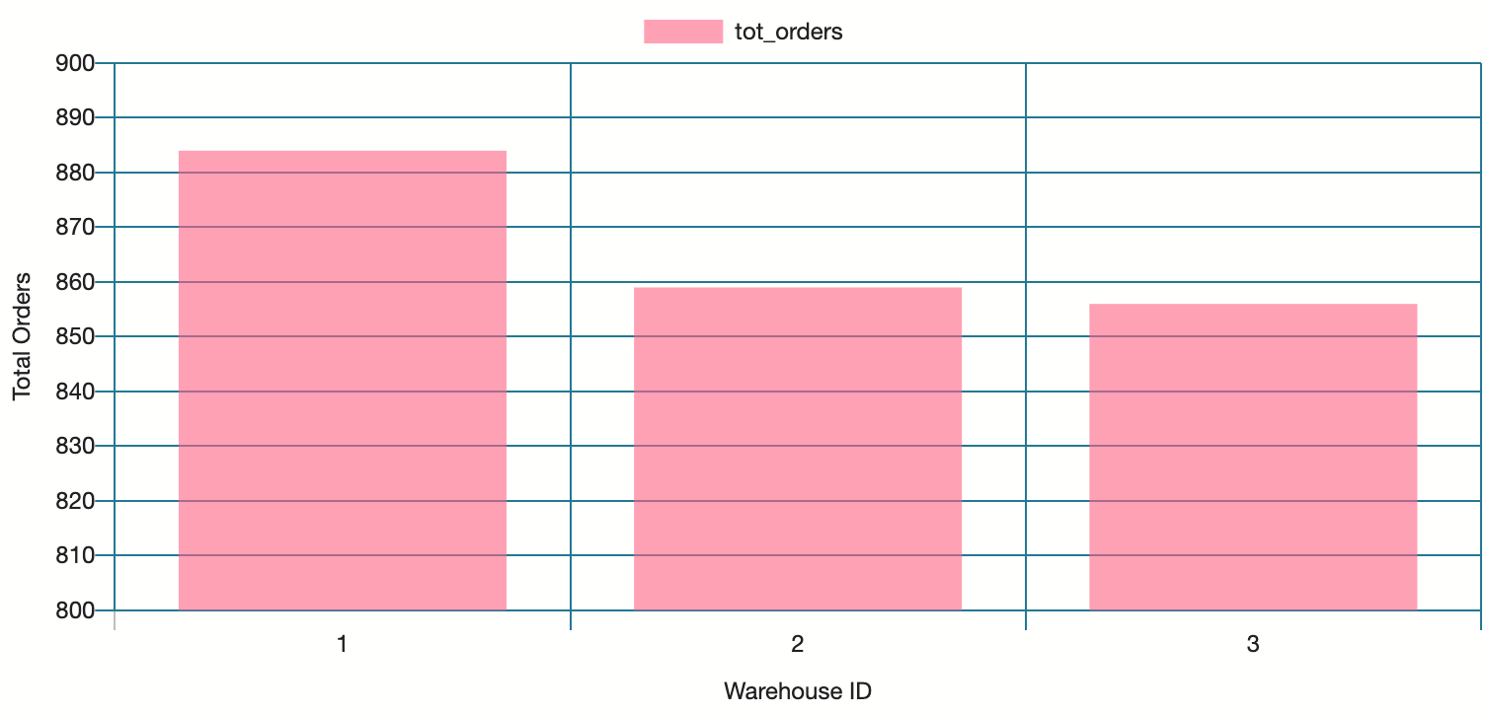
6c. Intermediate SQL Functions: Graphing Results
Total mountain bike sales over time.
Total mountain bike orders (2000-2019)
Total orders per warehouse.

Slide 14
7a. Advanced SQL Functions: Defining Advanced Functions
Common advanced SQL functions include CTEs, Windows Functions, and REGEX.
We will be using advanced function to gather more insight on the OPC data, which will hopefully allow us to answer our research questions.

Slide 15
7b. Advanced SQL Functions: Executing Advanced Queries
Question: Does OPC have adequate sales to support continued growth in the mountain bike segment?
Query: Find the percentage growth for the total sales of mountain bikes each year.
Answer: To see the percentage growth, look to the next slide for the graph (Section 3A).
Conclusion: The percentage growth in sales is too volatile to determine if there are adequate sales to support continued growth.
Question: Will the acquisition of Ord Cycles require OPC to increase its number of warehouses to meet demand?
Query: Find the wait time for each customer. Assuming no customers had expedited orders, categorize wait times as FAST, MODERATE, or SLOW. Then, count the totals for each wait time category for each warehouse.
Answer: The warehouses perform on the same level for each category (Section 3B).
Conclusion: With less than a 1/3 of the orders delivered at slow speeds for each warehouse, it might be beneficial to increase the number of warehouses to meet demands.
Question: Should Ord Cycles be acquired, what configurations of mountain bikes should OPC require Ord Cycles to build based on available data?
Query: Find the top 10 popular mountain bikes for 2019 by looking at the total orders. Then, find the associated build names for those bikes.
Answer: We saw 54 orders in 2019. The top 10 bikes from this year was different from the overall top 10 bikes as seen on the graph in the next slide. (Section 3C).
Conclusion: Because the number of sales for 2019 is low, we would need more sales data from the recent years (post 2019) to determine which bikes we should focus on.

Slide 16
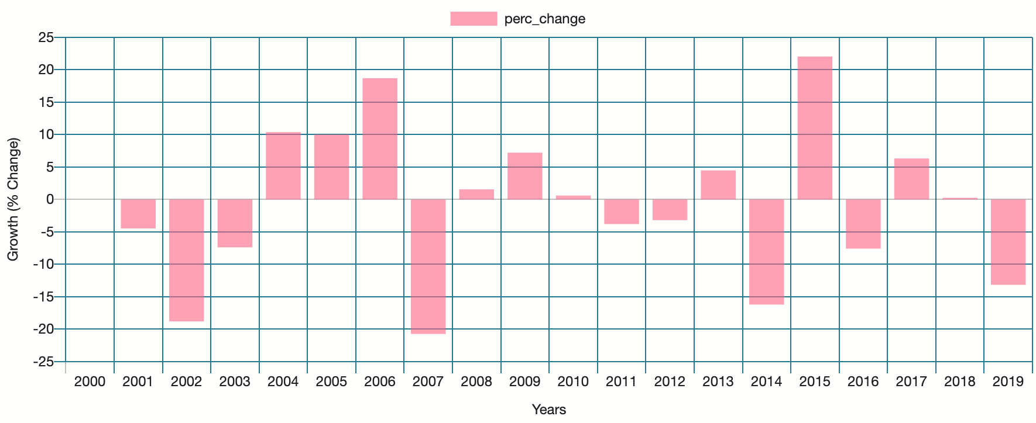
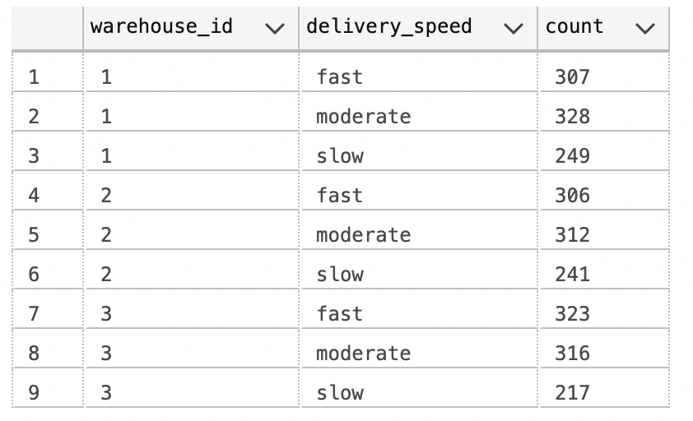
7c. Advanced SQL Functions: Graphing Results Part 1
Percent change in sales over time.
Comparing warehouse delivery speeds.

Slide 17
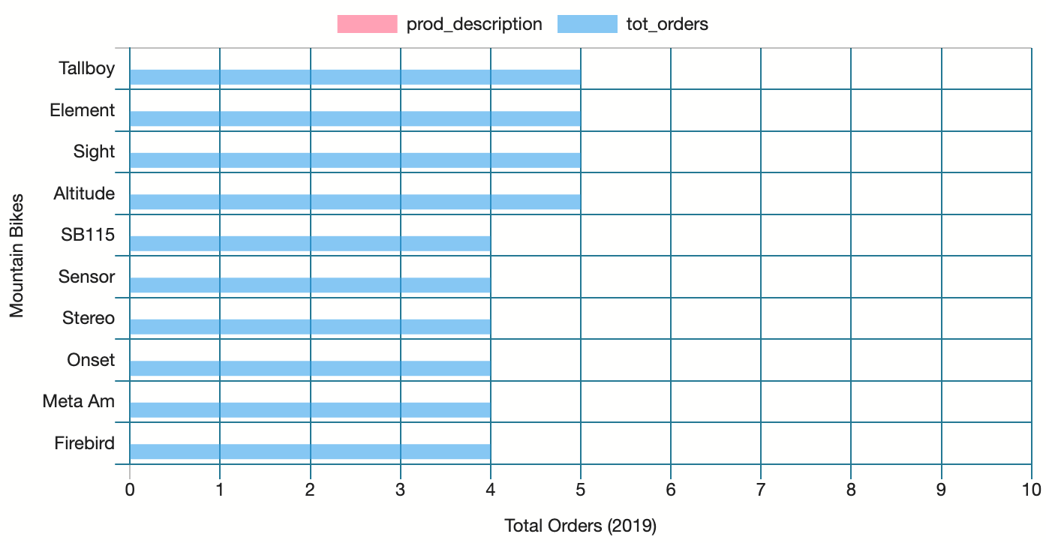
7c. Advanced SQL Functions: Graphing Results Part 2
Comparing top 10 most popular bikes in 2019 vs over time (2000-2019)

Slide 18
8a. Query Optimization: Importance
Query optimization is important, especially when dealing with large amounts of data, as it allows users to efficiently utilize database resources and increase task performance (Medium). Query planning is important for optimizing your queries.
PostgreSQL uses EXPLAIN and EXPLAIN ANALYZE to output the costs of executing queries.
We will look at a query that we previously executed to examine the costs and demonstrate the importance of query optimization (See Section 4).

Slide 19
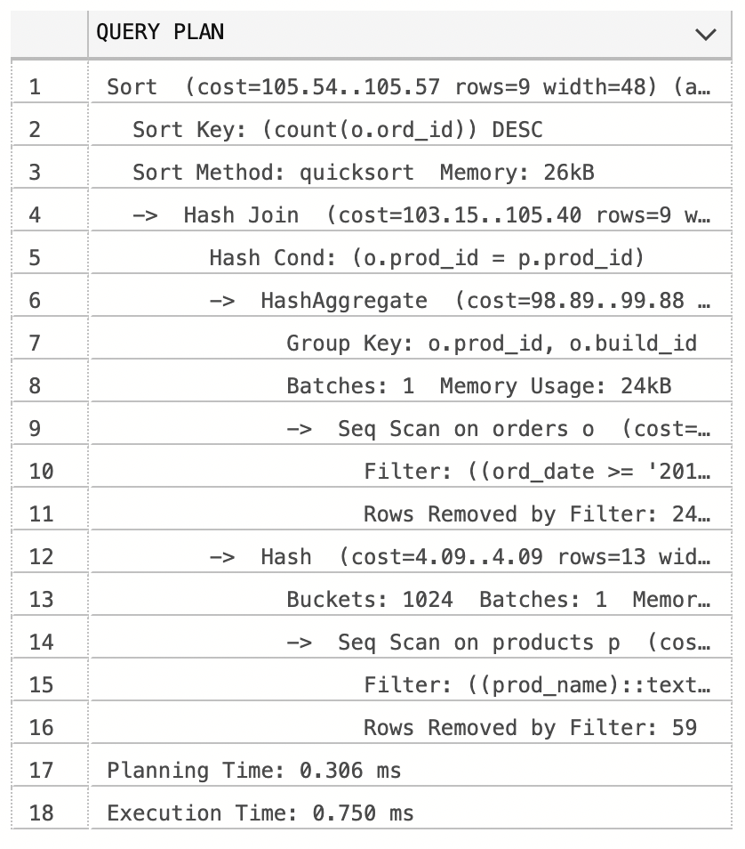
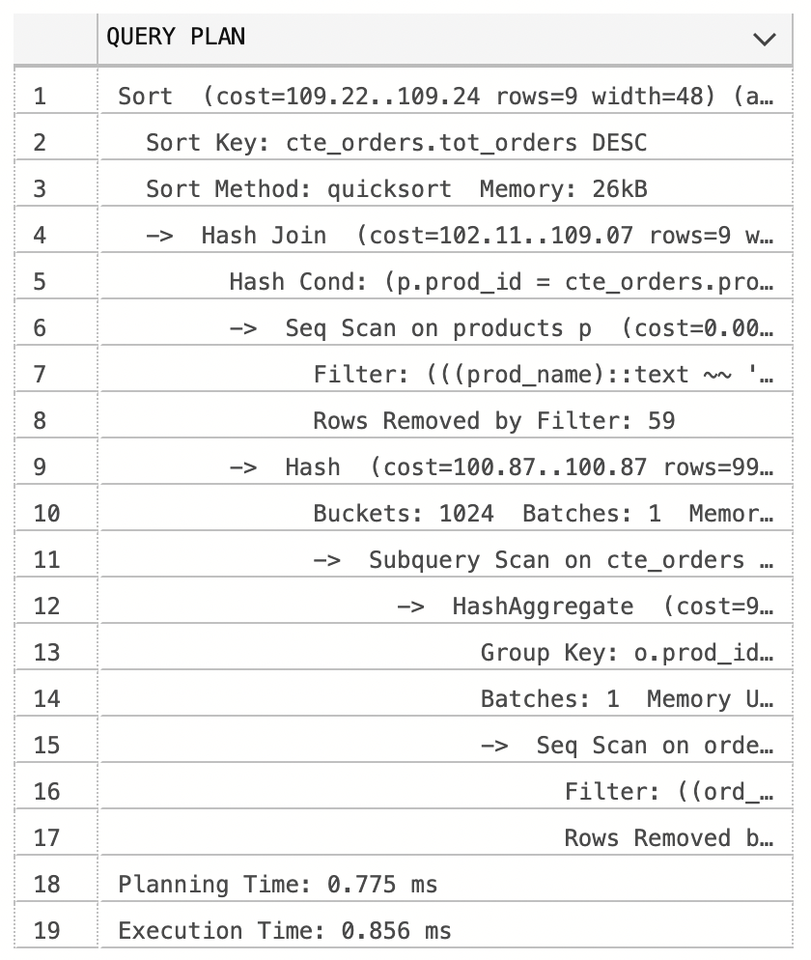
8b. Query Optimization: Query Comparison
For our query in Section 3C, we used IN to find strings within the prod_name column, but what would happen if we used multiple OR statements instead?
If we look at the planning times and executions times, we can see it takes less time when we use IN versus multiple OR statements, making it more optimal.
IN
Multiple OR Statements

Slide 20
9. Key Findings
Does OPC have adequate sales to support continued growth in the mountain bike segment?
The findings show that the growth in sales is too volatile to determine if there are adequate sales to support continued growth. In the most recent year (2019), there was -13.16% decrease in sales. There may be recovery in the future, but we would need more data over time.
Will the acquisition of Ord Cycles require OPC to increase its number of warehouses to meet demand?
Less than one-third of the orders for each warehouse has slow delivery times. This could be improved with an additional warehouse to offload the stress on the current warehouses. More research would need to be conducted to determine, which area would be best to add a new warehouse.
Should Ord Cycles be acquired, what configurations of mountain bikes should OPC require Ord Cycles to build based on available data?
Because there is not enough data in the recent years to determine the most current popular bikes, we would need to look at the overall data (2000-2019). From the overall data, OPC should require Ord Cycles to build more Occam, Altitude, Clash, Sight, Megatrail, Meta Am, Hei Hei, Mojo, Instinct, and Reactor bikes.

Slide 21
10. Lessons Learned
Throughout the course, we have learned to use PostgreSQL to…
Create and manage a database.
Execute advanced SQL functions.
Perform analyses on large sets of data to make informed decisions.
Optimize queries to create a functional and readable workspace.

Slide 22
11. Recommendations
We do not suggest acquiring Ord Cycles right now based on their current sales growth. If future data shows improvement, then we may reconsider.
We need more sales data from recent years (post 2019) to determine which bikes are currently in demand with customers.
An additional warehouse may be required if Ord Cycles plans to improve warehouse delivery times.

Slide 23
12. Sources
https://www.oracle.com/database/what-is-database/
https://medium.com/swlh/how-to-optimize-your-sql-query-2a5f0f422887

